Slide 1
Blood Donation
By
Mirza Ebnul Mahmood Shovan(011 162 058)
&
Samir Hossain(011 162 075)

Slide 2
Introduction:
Blood Donation is an information system where anyone who in need of blood will be able to search and contact with donor, add donor information and delete donor information from list.

Slide 3
Description:
In this project we used database to store information.
There is a login page for security, an Add donor page where we can add donor information, a Search page where anyone can search donor, a Update page where we can edit or delete donor.

Slide 4
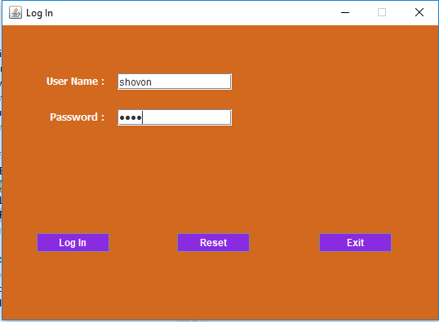
Screenshot:

Slide 5
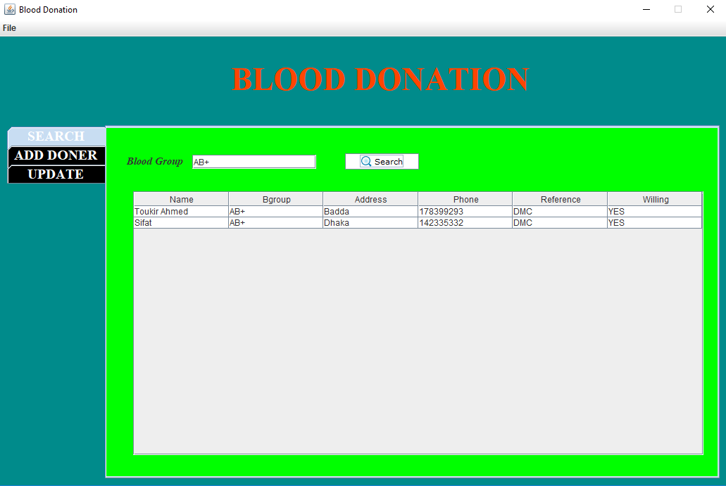
Screenshot:

Slide 6
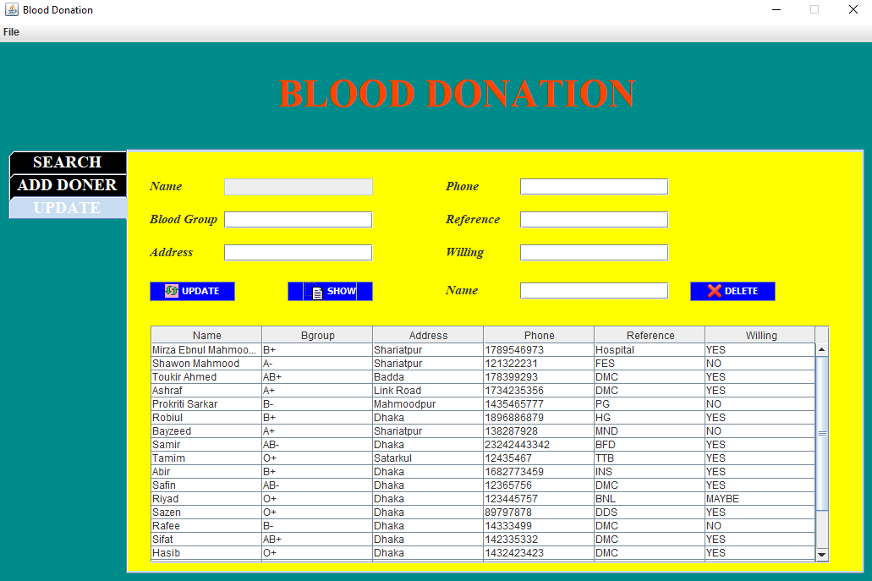
Screenshot:

Slide 7
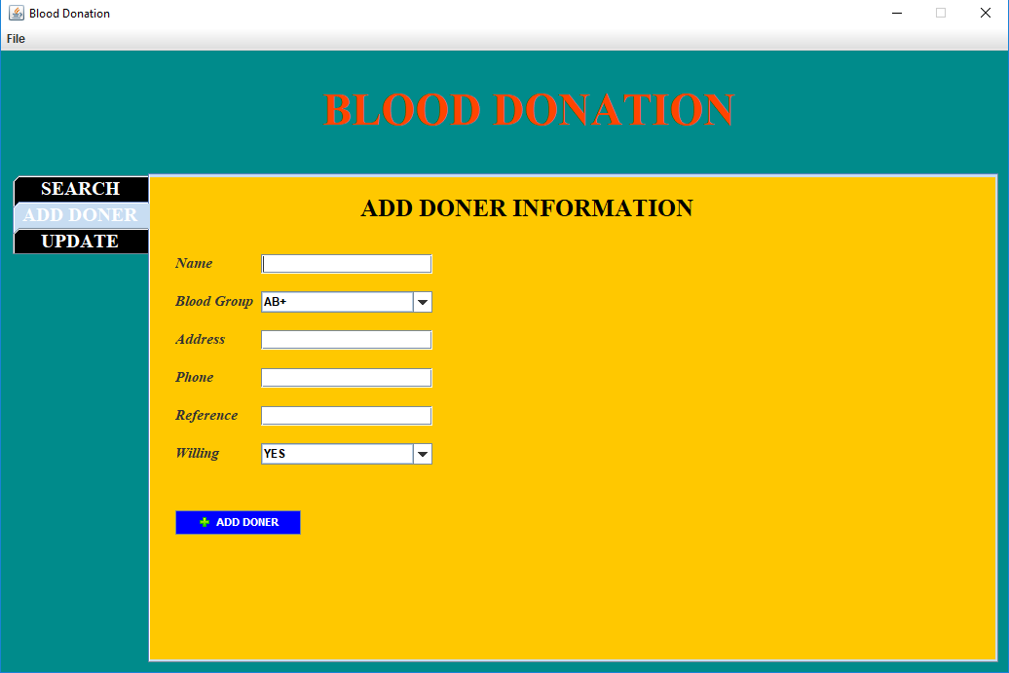
Screenshot:

Slide 8
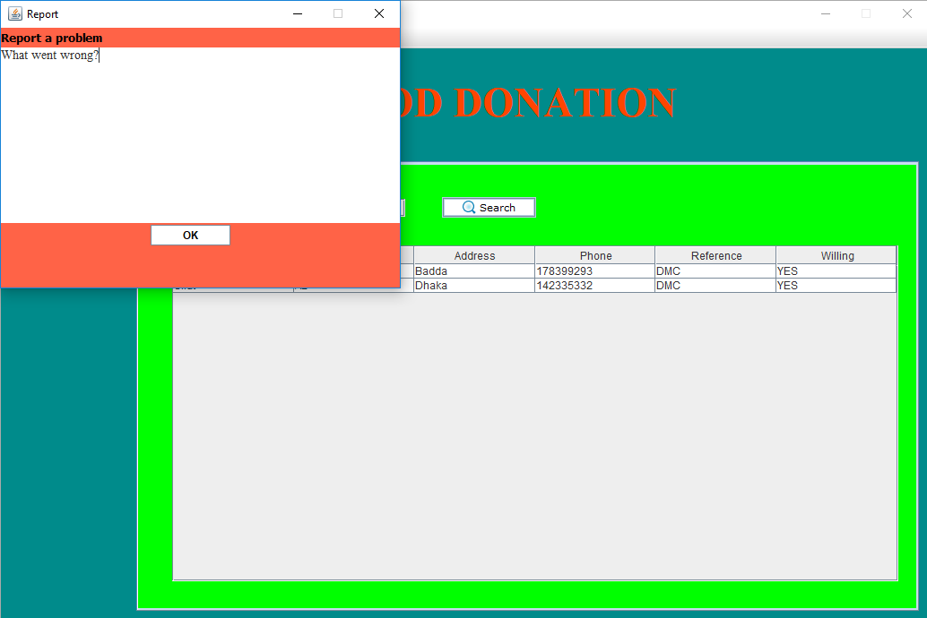
Screenshot:

Slide 9
Challenges:
The most challenging part was, java database connection while working on the project, we faced various difficulties but we didn’t lose hope and tried our best and finally we have completed our project.

Slide 10

THANK YOU

